Slide 1

House price prediction
Using Machine Learning
-Python
-XGBoost Regression

Slide 2
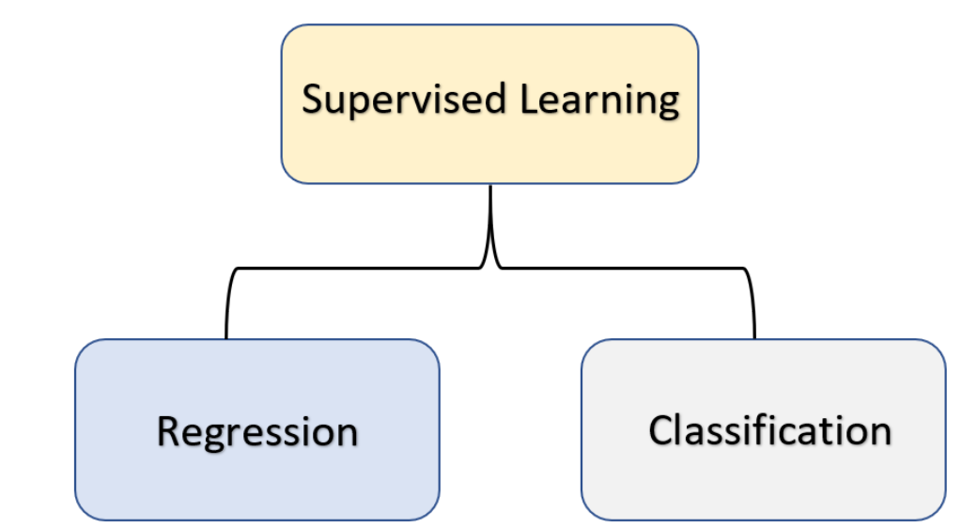

Slide 3
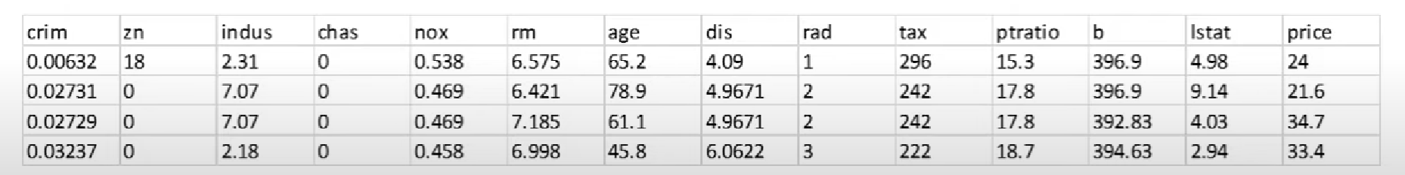
Boston House Price Dataset
The dataset used in the project comes from UCI Machine Learning Repository . The data was collected in
1978 and each of the 506 entries represents aggregate information about 14 features of homes from various located in Boston.

Slide 4
